Slide 1
Thermal Infrared Multispectral Scanner (TIMS): Remote Sensing Techniques and Geological Applications (Part II)
Jeffrey Bickel
Mentor: Lela Prashad
In Cooperation with Carmen Parks
Arizona State University

Slide 2
The Project
Remote sensing
Processing radiance, emissivity, and surface temperature
Color band images
Georeferencing the images

Slide 3
Compositional Analysis

Slide 4
Surface Temperature

Slide 5
Analyzing Volcanic Fields

Slide 6
J-Earth
User-friendly web based tool that is useful for scientists
All data will be available through the program

Slide 7
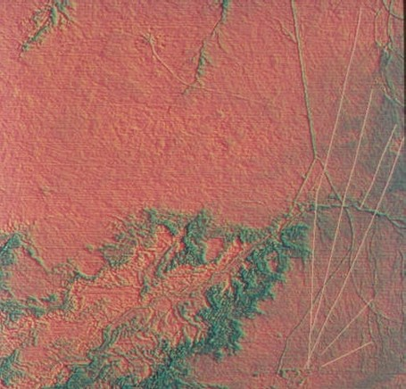
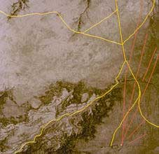
Other Applications
http://www.ghcc.msfc.nasa.gov/archeology/chaco_compare.html

Slide 8
My Project and Further Research

Slide 9
Thank You

